Slide 1
Parallel Programming with Message Passing on UNIX
Lecture 10 (Part C)

Slide 2
What is parallel computing
do a job with 2+ processors
single processor
multi-processors

Slide 3
Shared Memory Programming Model
from the tradition of multi-programming
Virtual address spaces for a
collection of processes communicating
via shared addresses
Machine physical address space
P
n
p
r
i
v
a
t
e
L
o
a
d
P
n
Common physical
addresses
P
P
2
P
1
0
S
t
o
r
e
P
p
r
i
v
a
t
e
Shared portion
of address space
2
Private portion
of address space
P
1
p
r
i
v
a
t
e
P
0
p
r
i
v
a
t
e

Slide 4
Message Passing Programming Model
Match
Receive
Y
,
P
,
t
Send
X, Q, t
Addr
ess
Y
Addr
ess
X
Local pr
ocess
Local pr
ocess
addr
ess space
addr
ess space
Pr
ocess
P
Pr
ocess
Q

Slide 5
System calls to use message passing mechanism on UNIX
msgq_id = msgget (key, flag)
msgsend (msgq_id, buf, size, flag)
msgrcv (msgq_id, buf, size, type, flag)

Slide 6
How to write message passing program on UNIX
Demo: msgq_rec

Slide 7
What you have to know
initializing a message queue
packet format
system call to send a message
system call to receive a message

Slide 8

Initializing a message queue
msgq_id = msgget (key, flag)
key: to identify a message queue
IPC_PRIVATE to force create one
flag: integer bitmap of usage permission
the same to file access permission

Slide 9
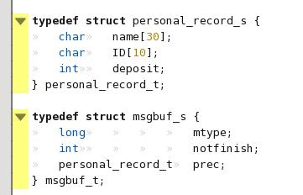
Packet format
address
mtype
user defined format
integer (long) type of the message type

Slide 10

Sending a message
msgsnd (msg_queue_id, *data_buf, data_size, flag)
data_size: exclude message type
flag: integer bitmap to represent sending option (e.g. blocking or non-blocking)

Slide 11
Receiving message
msgrcv (msg_queue_id, *data_buf, message_type, flag)
flag: integer bitmap to represent sending option (e.g. blocking or non-blocking)

Slide 12
In-Class Exercise
write a dot-product with message passing

Slide 13
Next Lecture
network programming on UNIX
socket
Chap. 16-17

